Slide 1



Sentiment Classification Using Logistic Regression and Feedforward Neural Networks
Group 4
Navreet
Aiswarya Hariharan
Kishankumar Patel
Rutvikkumar Suhagiya

Slide 2


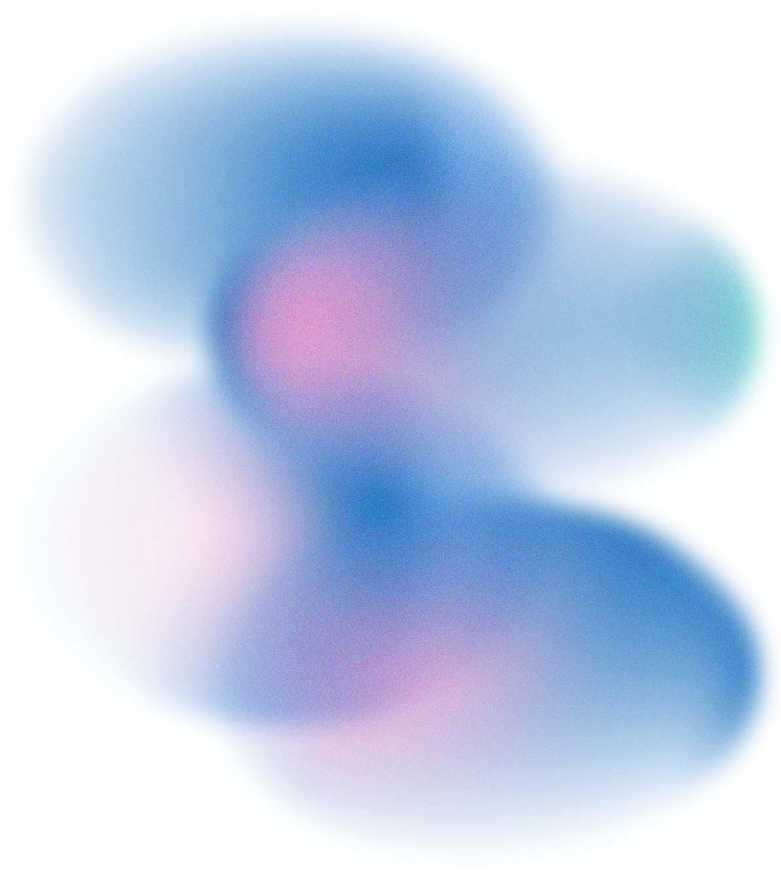
01
Introduction & Motivation
02
Project Objectives
03
System Architecture Overview
04
Dataset Description & Preprocessing
05
Logistic Regression Baseline Model
06
Feedforward Neural Network (FNN) Architecture
07
Hyperparameter Experiments
TABLE OF CONTENTS
Best FNN Model Results
08
09
Model Comparison: Logistic Regression vs FNN
10
Conclusion, Limitations & Future Work

Slide 3


Introduction
Sentiment analysis automatically determines whether a review expresses positive or negative emotion.
It is widely used in:
Movie review platforms (IMDB, RottenTomatoes)
E-commerce (Amazon feedback insights)
Social media monitoring
Customer service analytics
Why automate sentiment analysis?
Massive volume of user-generated text
Manual labeling is slow and subjective
Businesses rely on data-driven insights
Goal
Evaluate if deep learning (FNN) provides measurable improvements over a classical ML baseline (Logistic Regression) on the IMDB dataset.

Slide 4

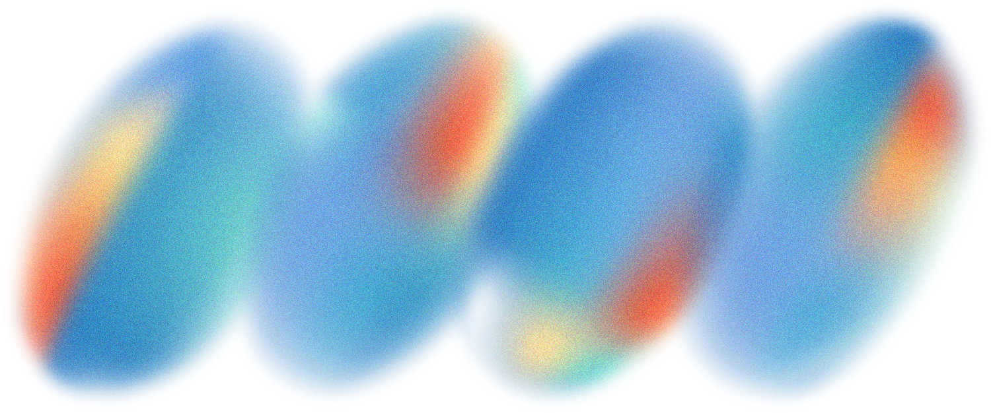
Project Objectives
OBJECTIVE 1
OBJECTIVE 2
OBJECTIVE 3
Build a complete sentiment classification pipeline from raw text to predictions, including NLP preprocessing (cleaning, tokenization) and TF-IDF feature extraction.
Develop and evaluate two models—a Logistic Regression baseline and a Feedforward Neural Network—while conducting hyperparameter experiments on activation functions (ReLU, Tanh), optimizers (Adam, SGD), and hidden layer sizes (16, 32, 64).
Compare model performance using accuracy, loss/accuracy curves, confusion matrices, and precision/recall/F1-score to determine the most effective approach for sentiment classification.

Slide 5
Dataset ingestion:
Loading 50K IMDB reviews and selecting a 10K subset for experimentation.
Text preprocessing:
Cleaning text, removing noise, applying TF-IDF vectorization.
Model training:
Logistic Regression
Feedforward Neural Network (multiple configurations)
Model evaluation:
Measuring accuracy, stability, confusion matrices, and training curves.
Hyperparameter tuning:
Studying how activation, optimizer, and hidden-layer size affect performance.
System Overview

Slide 6

Dataset Description
50 K
IMDB Movie Review Dataset
50,000 labeled movie reviews
Balanced dataset:
25,000 positive
25,000 negative
Text lengths vary from short comments to long paragraphs
Provides real-world sentiment complexity:
Sarcasm
Mixed sentiment
Informal writing
Subset for training
10,000 samples were used to make experimentation more computationally efficient.
Labeled movie reviews with 25000 positive & 25000 negative
10K
Samples were used for the experiment

Slide 7
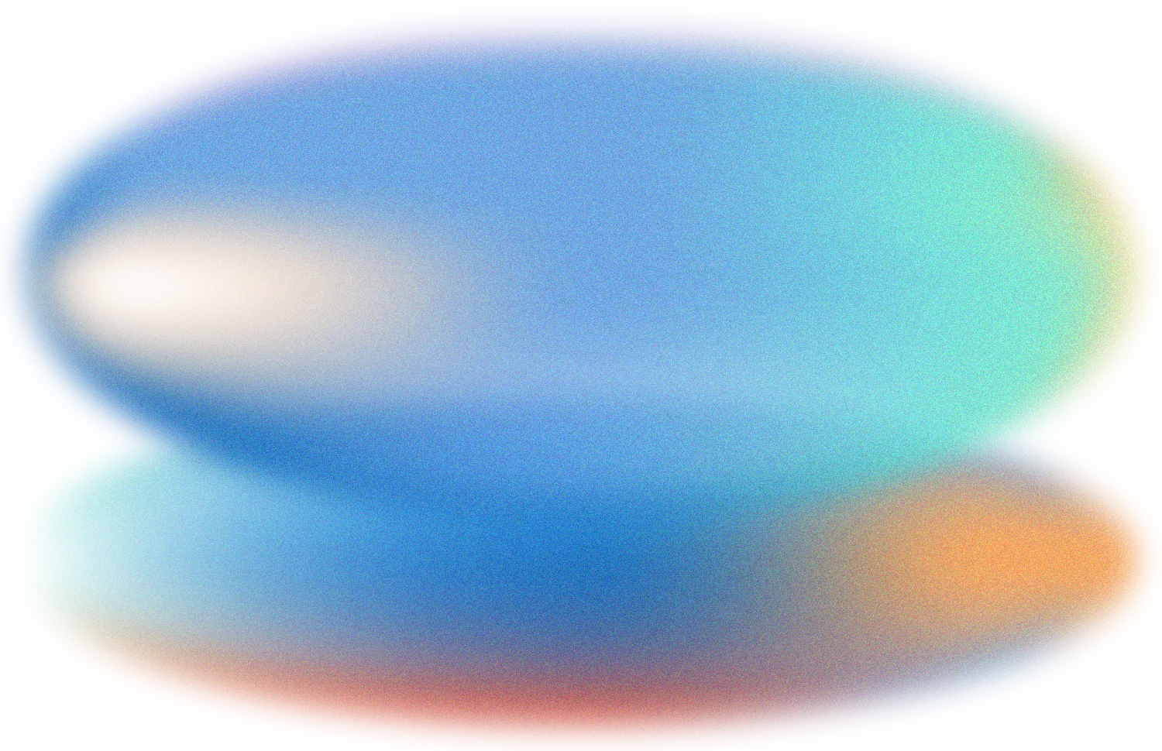
Text Preprocessing
Why TF-IDF?
Steps applied to each review:
Lowercase conversion
Remove HTML tags and scripts
Remove URLs
Remove punctuation
Normalize whitespace
TF-IDF vectorization (max 10,000 features)
Reduces noise by removing common stopwords
Assigns weights to meaningful words
Prevents dominance of frequent but uninformative terms
Works extremely well with linear models like Logistic Regression

Slide 8
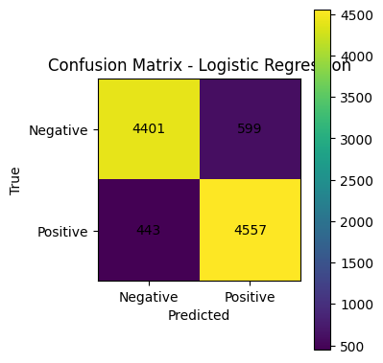
Logistic Regression Baseline
Characteristics
Linear classifier
Uses weighted TF-IDF features
Predicts probability of positive sentiment
Interpretable and computationally efficient
Performance
Accuracy: ~0.889
Performs strongly because:
TF-IDF features are sparse and high-dimensional
Logistic Regression handles linear separability well
Key Insight
Logistic Regression is difficult to outperform on TF-IDF features unless deep learning incorporates richer text representation.

Slide 9
Feedforward Neural Network Architecture
Network Structure
Input: 10,000-dimensional TF-IDF vector
Hidden Layer 1: Dense(16–64), ReLU/Tanh
Dropout(0.3) to prevent overfitting
Hidden Layer 2: Dense(hidden_units/2), activation
Output Layer: Dense(1), Sigmoid
Training Setup
Binary Cross-Entropy loss
Optimizers: Adam or SGD
Epochs: 5 (constant across experiments)
Batch size: 64
Validation split: 10%
Why FNN?
Captures nonlinear relationships
Flexible architecture
Baseline for deeper neural systems (CNNs, LSTMs)

Slide 10
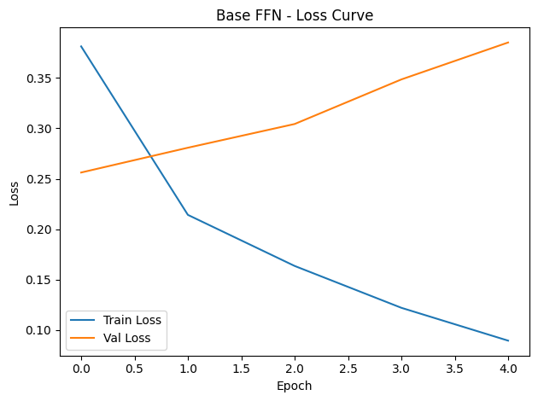
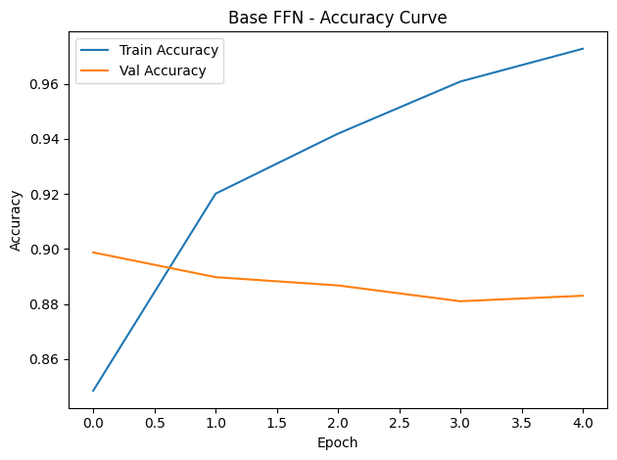
Base FNN Training Performance
Training Observations
Training accuracy improves steadily across epochs
Validation accuracy trends similarly → stable training
Loss decreases smoothly → consistent learning
No signs of overfitting with dropout
FNN slightly underperforms LR but remains competitive

Slide 11
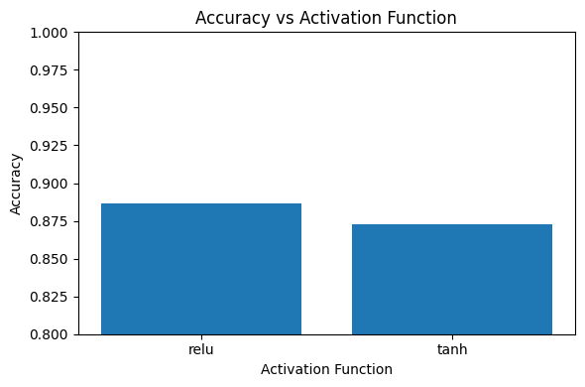
Experiment 1: Activation Functions
Tested
ReLU
Tanh
Results
ReLU: 0.8852 → highest
Tanh: 0.8720 → lower
Why ReLU wins
Handles sparse high-dimensional data well
Mitigates vanishing gradients
Faster gradient propagation
Conclusion
ReLU is the optimal activation function for this dataset.

Slide 12
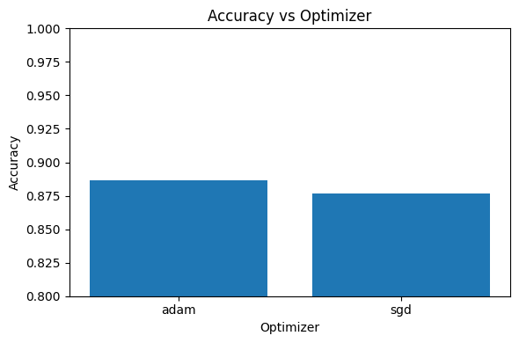
Experiment 2: Optimizers
Tested
Adam
SGD
Results
Adam: 0.8852 (best)
SGD: 0.8827
Why Adam wins
Adaptive learning rate
Fast convergence
Better performance on noisy gradients
Works extremely well with TF-IDF
Conclusion
Adam is slightly superior, though SGD remains competitive.

Slide 13
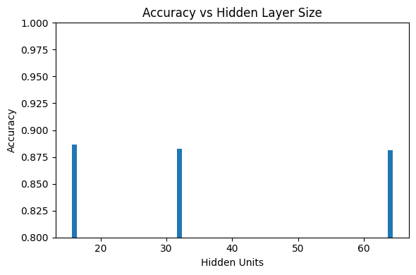
Experiment 3: Hidden Units
Tested
16
32
64
Accuracies
16 units: 0.8852 → best model
32 units: 0.8817
64 units: 0.8804
Interpretation
More neurons ≠ better performance
Smaller network generalizes better
TF-IDF vectors do not require large capacity networks

Slide 14
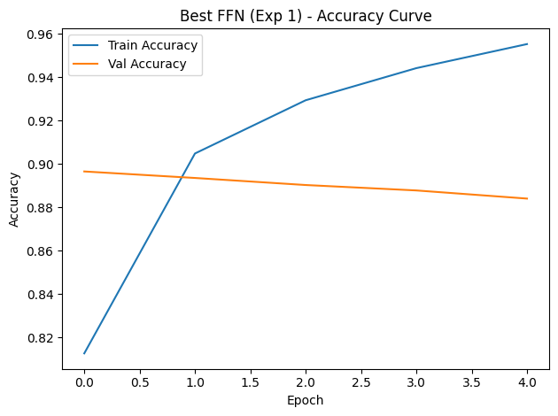
Best FNN Configuration
Best Model
Hidden units: 16
Activation: ReLU
Optimizer: Adam
Learning rate: 0.001
Final accuracy: 0.8852
Training Behavior
Smooth loss reduction
Stable accuracy curve
Minimal overfitting

Slide 15
Logistic Regression vs FNN
Final Comparison
Key Insight
ModelAccuracy
Logistic Regression : 0.889
Best FNN : 0.8852
Logistic Regression slightly outperforms FNN on sparse TF-IDF vectors.
LR remains strong for text classification without embeddings.
FNN becomes more useful when:
Word embeddings are used
Sequence models (RNN/LSTM) are applied
More complex architectures are allowed

Slide 16
Final Conclusion
Key Findings
TF-IDF features work extremely well with Logistic Regression.
FNN performs competitively but does not surpass LR.
ReLU and Adam are the optimal hyperparameters for this dataset.
Smaller networks (16 units) performed best → avoids overfitting.
Limitations
TF-IDF ignores word order and semantic relationships
Neural network performance limited by lack of embeddings
Dataset contains complex sentiment cues (sarcasm, mixed polarity)
Future Work
Use word embeddings (Word2Vec, GloVe, FastText)
Apply sequential models: LSTM, GRU, Transformer
Perform large-scale hyperparameter optimization
Compare additional deep learning architectures

Slide 17
IMDb Movie Reviews Dataset (Kaggle)
https://www.kaggle.com/datasets/lakshmi25npathi/imdb-dataset-of-50k-movie-reviews
LeCun, Bengio & Hinton. Deep Learning.
https://doi.org/10.1038/nature14539
Zhang, Zhao & LeCun. Text Classification with Neural Networks.
https://arxiv.org/abs/1509.01626
Pang & Lee. Opinion Mining and Sentiment Analysis.
https://doi.org/10.1561/1500000011
References

Slide 18
Thank You

